Slide 1
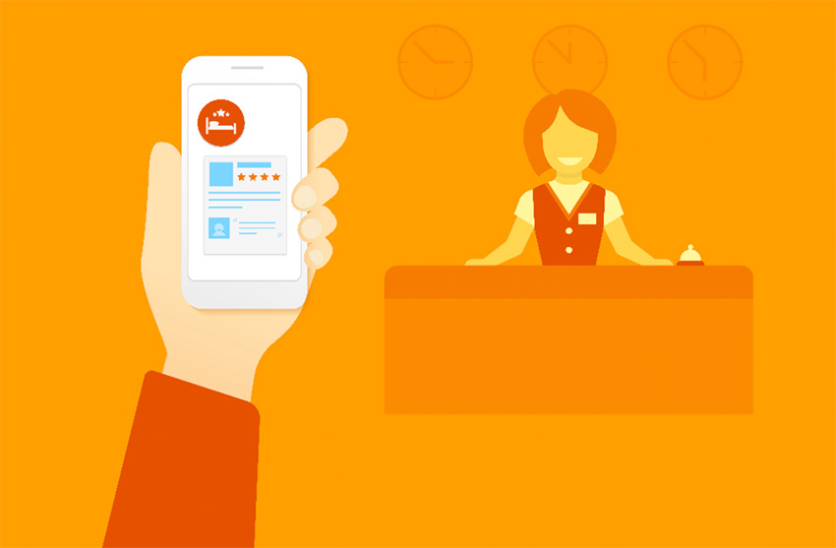
TITLE OF THE PROJECT
Hotel Room Booking Application

Slide 2
TEAM MEMBERS
HARMAN C++ Batch 5
Bhagya Shri T
Prakruthi C Gowda
Soumya Basapur
Vinay Kasimahanthi

Slide 3
CONTENTS
Introduction
Software Requirements
Subjects/Concepts Used
An Overview of the Project
Database
Screenshots
Future Scope

Slide 4



INTRODUCTION

Slide 5
SOFTWARE REQUIREMENTS
Operating System: Windows
IDE: Code Blocks
Web Server used: Xampp (MySQL database)
Compiler: GCC

Slide 6
SUBJECTS / CONCEPTS USED
2 main subjects were used while designing the project. They are mentioned below.
Object Oriented Programming using C++
Database Management System

Slide 7
AN OVERVIEW OF THE PROJECT
Step 1: Compile the code using GCC compiler and run it, in command prompt.
Step 2: Create the database.
Step 3: Import SQL file to create database connection.
Step 4: Open the .cpp file and run the program.

Slide 8
DATABASE
Hotel ID | Hotel Management
1 | Ashoka Grand
2 | Hotel Taj
3 | Leela Palace
4 | Lalith Mahal

Slide 9
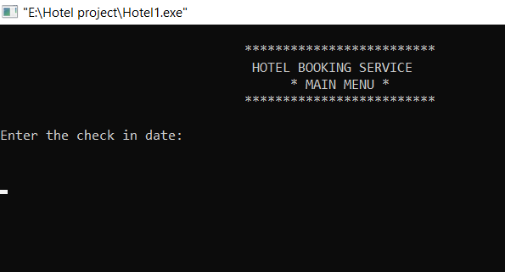
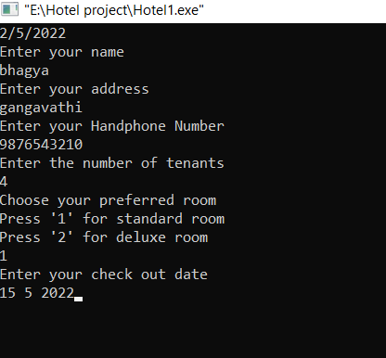
SCREENSHOTS

Slide 10
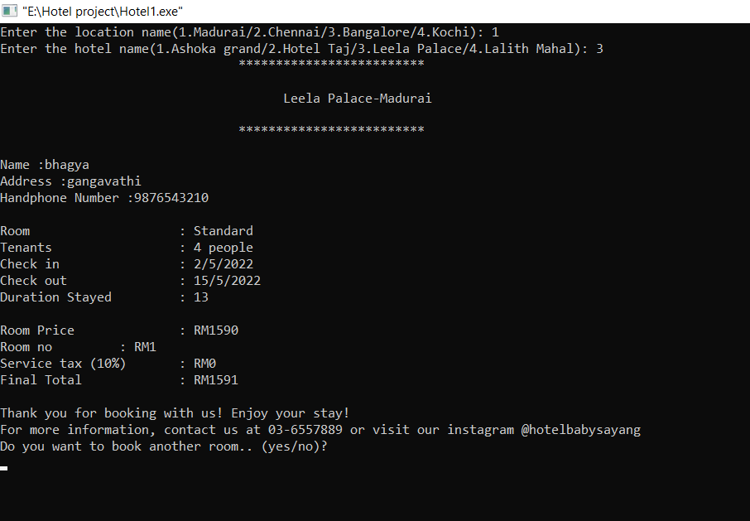

Slide 11
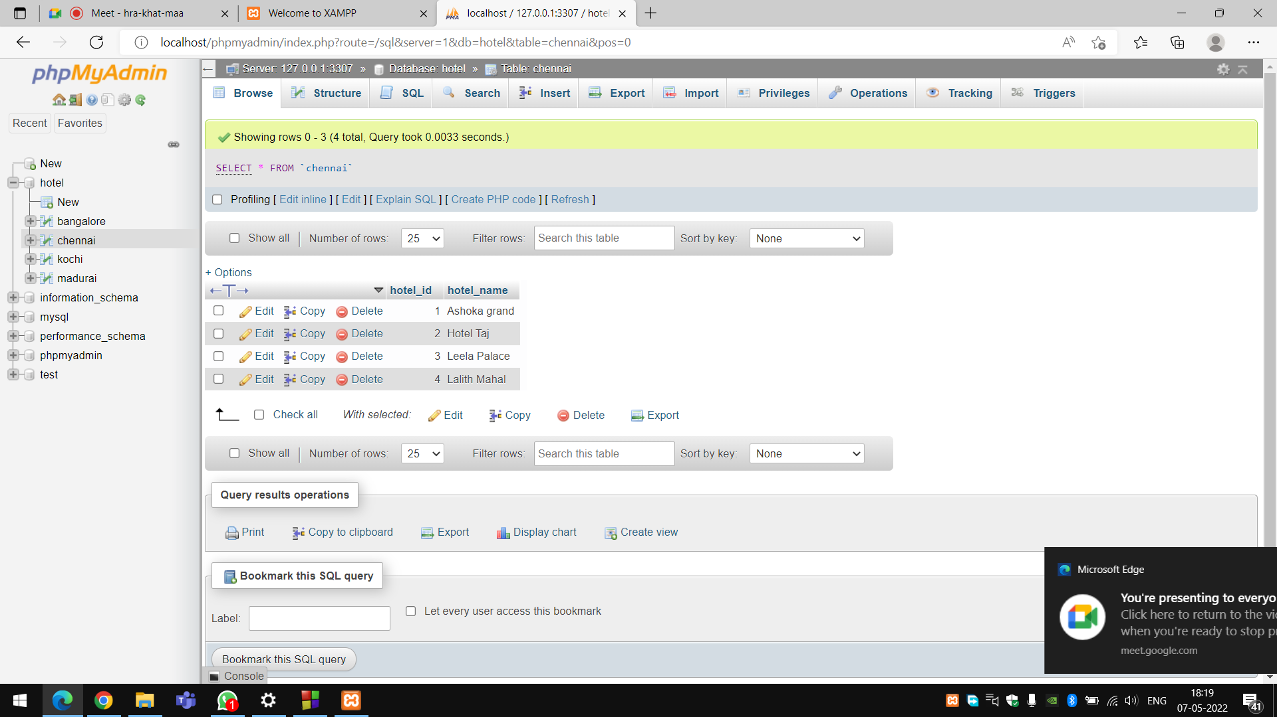

Slide 12



FUTURE SCOPE OF THE PROJECT

Slide 13
QUESTIONS?
In case you have some questions to ask, please do not hesitate. My team and I shall try our best to answer.

Slide 14
THANK YOU!

